Slide 1
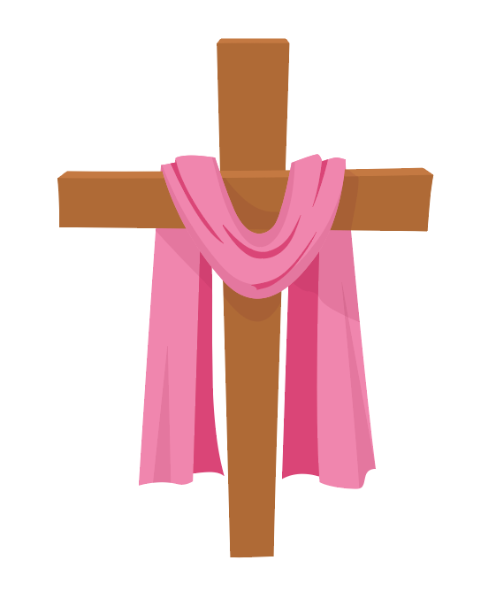

’S e Didòmhnaich na Càisge a th’ ann.
Notes:
It’s Easter Sunday.

Slide 2


Tha i brèagha a-muigh.
Notes:
It is lovely outside.

Slide 3
Bidh sinn a’ cur oirnn aodach ùr.
Notes:
We will put on our new clothes.

Slide 4
Bidh sinn a’ dol dhan eaglais.
Notes:
We will go to the church.

Slide 5
Bidh an eaglais trang an-diugh.
Notes:
The church will be busy today.

Slide 6
Bidh a h-uile duine toilichte.
Notes:
Everybody will be happy.

Slide 7
’S e latha sònraichte a th’ ann.
Càisg shona, dhuibh uile!
Notes:
It’s a special day. Happy Easter, everyone!

